Slide 1

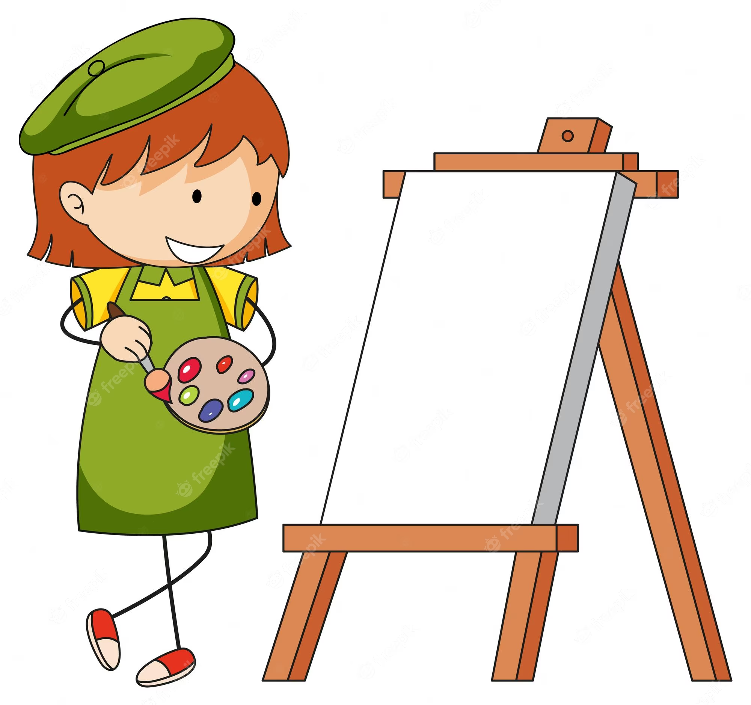
I am an Artist
Y3
Gestural Drawing with Charcoal
(Drawing & Sketchbooks)
Working with Shape and Colour
(Print, Colour, Collage)
Make marks using charcoal using hands as tools. Explore qualities of mark available using charcoal
Make charcoal drawings which explore Chiaroscuro and which explore narrative/drama through lighting/shadow (link to drama)
Option to explore making gestural drawings with charcoal using the whole body (link to dance)
Explore the qualities of charcoal
Make visual notes using a variety of media using the “Show Me What You See” technique when looking at other artists work to help consolidate learning and make the experience your own
Develop mark making skills.
Make visual notes using a variety of media using the “Show Me What You See” technique when looking at other artists work to help consolidate learning and make the experience your own.
Develop mark making skills.
Use mono print or screen print over collaged work to make a creative response to an original artwork.
Cut shapes from paper (free hand) and use as elements with which to collage, combined with printmaking to make a creative response to an original artwork. Explore positive and negative shapes, line, colour and composition.
Making Animated Drawings
(Working in 3 Dimensions)
Use imaginative and observational drawing skills to make drawings of people/animals which can be animated. Consider background, foreground and subject
Make visual notes using a variety of media using the “Show Me What You See” technique when looking at other artists work to help consolidate learning and make the experience your own
Develop mark making skills.
Brainstorm animation ideas
Cut out drawings and make simple articulations to make drawings which can be animated. Combine with digital media to make animations

Slide 2
I am an Artist
Y4
Storytelling Through Drawing
(Drawing & Sketchbooks)
Create owned narratives by arranging toys in staged scenes, using these as subject matter to explore creation of drawings using charcoal and chalk which convey drama and mood. Use light and portray light/shadow.
Interpret poetry or prose and create sequenced images in either an accordian or poetry comic format. Work in a variety of media according to intention, including handwriting pen, graphite or ink
Use a variety of drawing media including charcoal, graphite, wax resist and watercolour to make observational and experimental drawings. To feel able to take creative risks in pursuit of creating drawings with energy and feeling
Practise drawing skills
Make visual notes to record ideas and processes discovered through looking at other artists
Test and experiment with materials
Reflect
Exploring Pattern
(Print, Colour, Collage)
Use colour, composition, elements, line, shape to create pattern working with tessellations, repeat pattern or folding patterns.
Practise drawing skills.
Make visual notes to record ideas and processes discovered through looking at other artists.
Test and experiment with materials.
Brainstorm pattern, colour, line and shape.
Reflect.
Practise drawing skills
Make visual notes to record ideas and processes discovered through looking at other artists.
Test and experiment with materials.
Reflect
Develop our construction skills, creative thinking and resilience skills by making sculpture which combines lots of materials. Use tools to help us construct and take creative risks by experimenting to see what happens. Use Design through Making philosophy and reflect at all stages to inform future making.
Sculpture, Structure, Inventiveness & Determination
(Working in 3 Dimensions)

Slide 3
I am an Artist
Y5
Typography & Maps
(Drawing & Sketchbooks)
Making Monotypes
(Print, Colour, Collage)
Create fonts inspired by objects/elements around you. Use close observational drawing with pen to inspire, and use creative skills to transform into letters
Draw over maps/existing marks to explore how you can make mark making more visually powerful
Combine drawing with making to create pictorial / 3 dimension maps which explore qualities of your personality or otherwise respond to a theme.
Explore line weight, rhythm, grip, mark making and shape, and explore how 2d can become 3d through manipulation of paper
Explore mark making.
Make visual notes to capture, consolidate and reflect upon the artists studied.
Brainstorm ideas generated when reading poetry or prose.
Make visual notes to capture, consolidate and reflect upon the artists studied.
Combine mono type with painting and collage to make an “artists book” inspired by poetry or prose.
Explore colour, mixing different hues, and explore composition, working with different shaped elements, before using mono print to layer lines and marks
Explore how print is combined with paint and collage to create a cohesive artwork
Architecture: Dream Big or Small?
(Working in 3 Dimensions)
Explore ideas relating to design (though do not use sketchbooks to design on paper), exploring thoughts about inspiration source, materials, textures, colours, mood, lighting etc
Use Design through Making and scale models to create a piece of architecture which would make the world a better place.
Use a combination of materials, construction methods and tools.
Reflect as part of the building process so that you can understand how your intention relates to the reality of what you are building.

Slide 4
Y6
I am an Artist
2D Drawing to 3D Making
(Drawing & Sketchbooks)
Explore using negative and positive space to “see” and draw a simple element/object
Use the grid system to scale up the image above, transferring the image onto card.
Use collage to add tonal marks to the “flat image
Practise seeing negative and positive shapes.
Using the grid method to scale up an image
Develop Mark Making
Make visual notes to capture, consolidate and reflect upon the artists studied.
Activism
(Print, Colour, Collage)
Practise seeing negative and positive shapes
Explore what your passions, hopes and fears might be. What makes you you? How can you find visual equivalents for the words in your head?
Explore colour: make colours, collect colours, experiment with how colours work together
Explore combinations and layering of media.
Develop Mark Making
Make visual notes to capture, consolidate and reflect upon the artists studied
Explore what kinds of topics or themes YOU care about. Articulate your fears, hopes, dreams. Think about what you could create (possibly working collaboratively) to share your voice and passion with the world
Use screenprinting and/or monoprinting over collaged and painted sheets to create your piece of activist art. Or create a zine using similar method
Take a Seat
(Working in 3 Dimensions)
Make visual notes to capture, consolidate and reflect upon the artists studied
Use a variety of materials to design (through making) and construct a scaled piece of furniture.
Bring your personality and character to the piece.
Let your nature inform the choice of materials and shapes you use.

